Slide 1
Perceptron

Slide 2

Who
Pavlos Protopapas, Scientific Director of the Institute for Applied Computational Science (IACS). Teaches CS109a, CS109b and the Capstone course for the Data Science masters program. He is a leader in astrostatistics and he is excited about the new telescopes coming online in the next few years. He loves cooking and eating.

Slide 3
Outline
Introduction to Artificial Neural Networks
Review of Classification and Logistic Regression
Single Neuron Network (‘Perceptron’)

Slide 4
Watch this!
http://video.arstechnica.com/watch/sunspring-sci-fi-short-film

Slide 5
Artificial Neural Networks

Slide 6

Today’s news

Slide 7

Today’s news

Slide 8
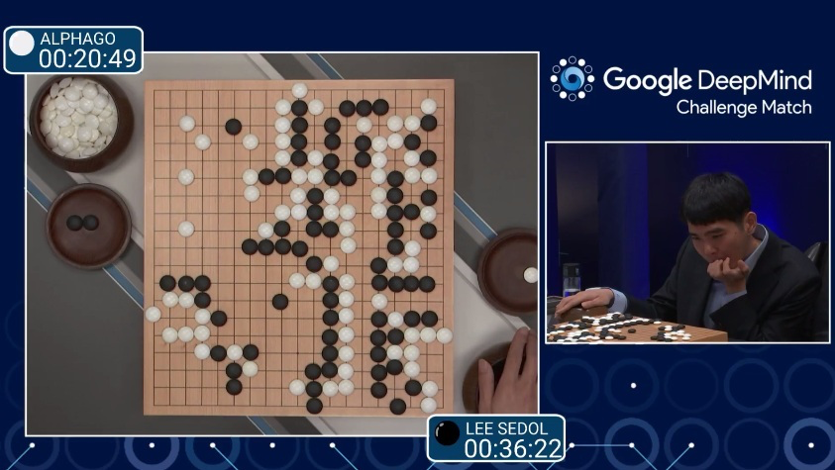
AlphaGo (2015)
First program to beat a professional Go player
Notes:
https://www.youtube.com/watch?v=PQCrX1sQSzY

Slide 9

AlphaZero (2017)

Slide 10

iOS Speech Synthesis (2016-)
Trained from 20 hours of high quality speech
machinelearning.apple.com
Notes:
https://machinelearning.apple.com/2017/08/06/siri-voices.html

Slide 11
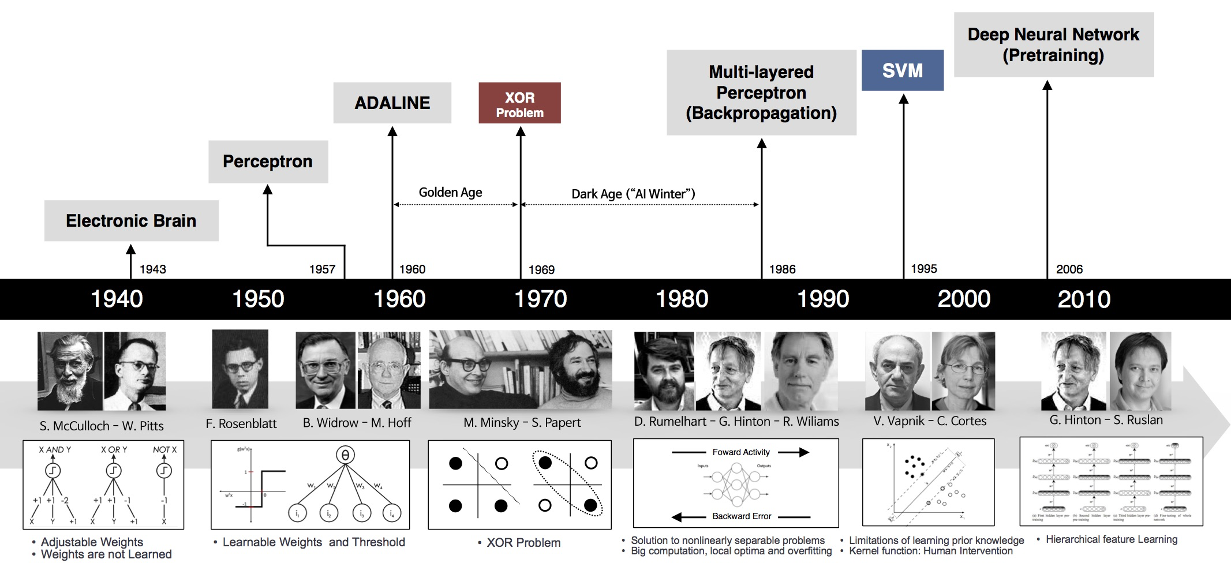
Historical Trends
beamandrew.github.io/

Slide 12
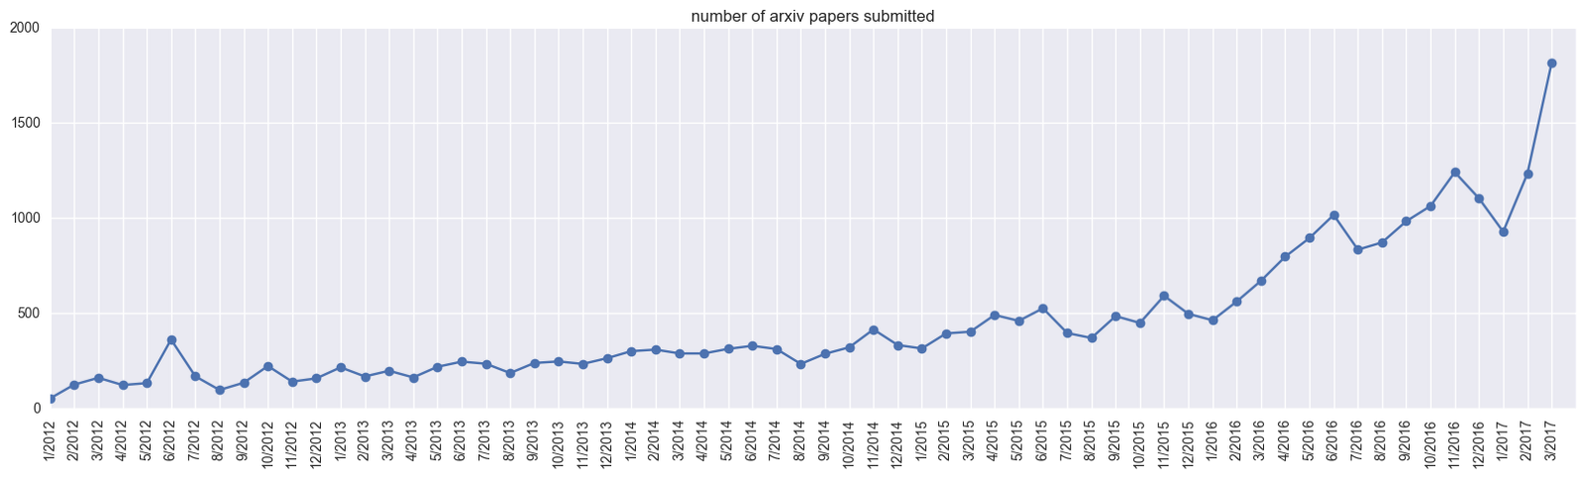
Historical Trends
ArXiv papers on deep learning: 2012-2017
ArXiv papers on deep learning: 2012-2017

Slide 13
Outline
Introduction to Artificial Neural Networks
Review of Classification and Logistic Regression
Single Neuron Network (‘Perceptron’)

Slide 14
Classification and Logistic Regression

Slide 15
Regression and Classification
Methods that are centered around modeling and prediction of a quantitative response variable (ex, number of taxi pickups, number of bike rentals, etc) are called regressions (and Ridge, LASSO, etc).
When the response variable is categorical, then the problem is no longer called a regression problem but is instead labeled as a classification problem.
The goal is to attempt to classify each observation into a category (aka, class or cluster) defined by Y, based on a set of predictor variables X.

Slide 16
Typical Classification Examples
The motivating examples for this lecture(s), homeworks and labs are based on classification. Classification problems are common in these domains:
Trying to determine where to set the cut-off for some diagnostic test (pregnancy tests, prostate or breast cancer screening tests, etc...)
Trying to determine if cancer has gone into remission based on treatment and various other indicators
Trying to classify patients into types or classes of disease based on various genomic markers

Slide 17
Data: Response vs. Predictor Variables
X
predictors
features
covariates
Y
outcome
response variable
dependent variable
TV | radio | newspaper | sales
230.1 | 37.8 | 69.2 | 22.1
44.5 | 39.3 | 45.1 | 10.4
17.2 | 45.9 | 69.3 | 9.3
151.5 | 41.3 | 58.5 | 18.5
180.8 | 10.8 | 58.4 | 12.9
n observations
p predictors

Slide 18
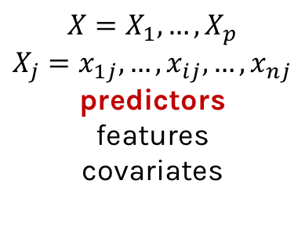
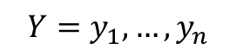
Response vs. Predictor Variables
$$X=X_{1},…,X_{p}$$
$$X_{j}=x_{1j},…,x_{ij},…,x_{nj}$$
predictors
features
covariates
outcome
response variable
dependent variable
$$Y=y_{1},…,y_{n}$$
TV | radio | newspaper | sales
230.1 | 37.8 | 69.2 | 22.1
44.5 | 39.3 | 45.1 | 10.4
17.2 | 45.9 | 69.3 | 9.3
151.5 | 41.3 | 58.5 | 18.5
180.8 | 10.8 | 58.4 | 12.9
n observations
p predictors

Slide 19
Heart Data
response variable Y
is Yes/No
Age | Sex | ChestPain | RestBP | Chol | Fbs | RestECG | MaxHR | ExAng | Oldpeak | Slope | Ca | Thal | AHD
63 | 1 | typical | 145 | 233 | 1 | 2 | 150 | 0 | 2.3 | 3 | 0.0 | fixed | No
67 | 1 | asymptomatic | 160 | 286 | 0 | 2 | 108 | 1 | 1.5 | 2 | 3.0 | normal | Yes
67 | 1 | asymptomatic | 120 | 229 | 0 | 2 | 129 | 1 | 2.6 | 2 | 2.0 | reversable | Yes
37 | 1 | nonanginal | 130 | 250 | 0 | 0 | 187 | 0 | 3.5 | 3 | 0.0 | normal | No
41 | 0 | nontypical | 130 | 204 | 0 | 2 | 172 | 0 | 1.4 | 1 | 0.0 | normal | No

Slide 20
Heart Data
These data contain a binary outcome HD for 303 patients who presented with chest pain. An outcome value of:
Yes indicates the presence of heart disease based on an angiographic test,
No means no heart disease.
There are 13 predictors including:
Age
Sex
Chol (a cholesterol measurement),
MaxHR
RestBP
and other heart and lung function measurements.

Slide 21
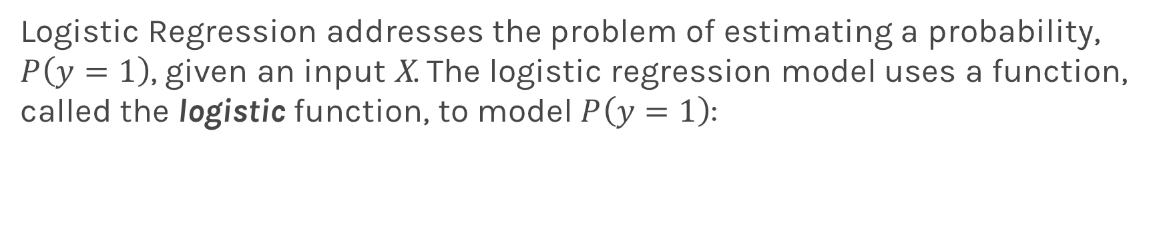
Logistic Regression
Logistic Regression addresses the problem of estimating a probability, $P\left(y=1\right)$, given an input X. The logistic regression model uses a function, called the logistic function, to model $P\left(y=1\right)$:

Slide 22
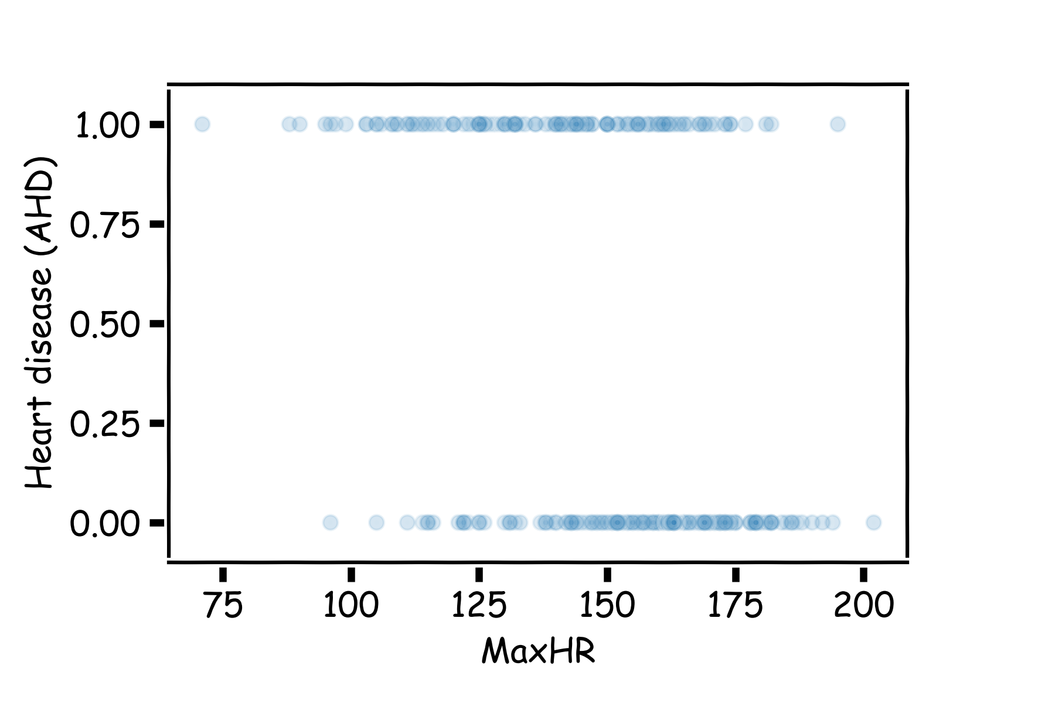
Heart Data: logistic estimation
We'd like to predict whether or not a person has a heart disease. And we'd like to make this prediction, for now, just based on the MaxHR.

Slide 23
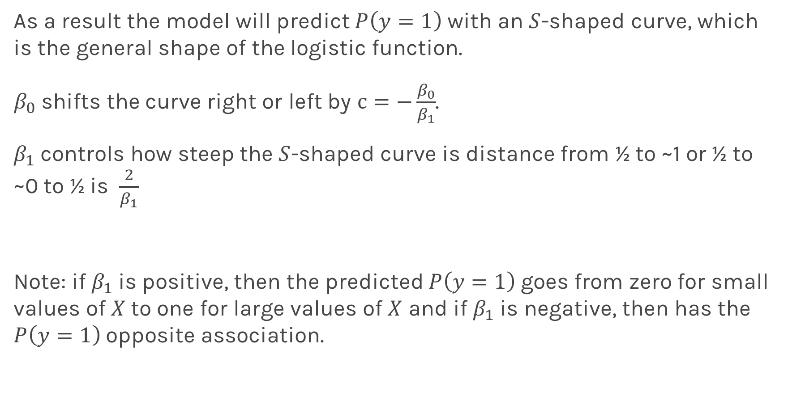
Logistic Regression
As a result the model will predict $P\left(y=1\right)$ with an $S$-shaped curve, which is the general shape of the logistic function.
$β_{0}$ shifts the curve right or left by $c=−\frac{β_{0}}{β_{1}}$.
$β_{1}$controls how steep the $S$-shaped curve is distance from ½ to ~1 or ½ to ~0 to ½ is $\frac{2}{β_{1}}$
Note: if $β_{1}$is positive, then the predicted $P\left(y=1\right)$goes from zero for small values of $X$to one for large values of $X$ and if $β_{1}$is negative, then has the $P\left(y=1\right)$opposite association.

Slide 24
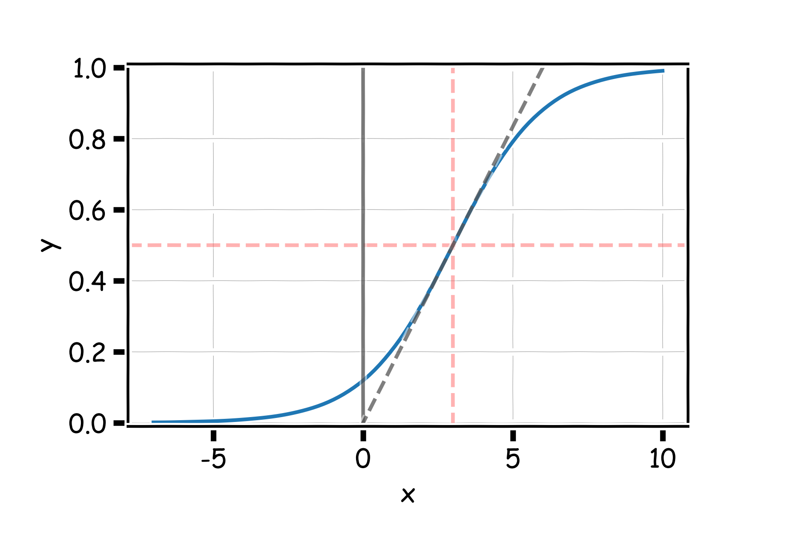
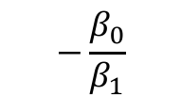

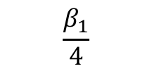
Logistic Regression
$$2β_{1}$$
$$−\frac{β_{0}}{β_{1}}$$
$$\frac{β_{1}}{4}$$

Slide 25
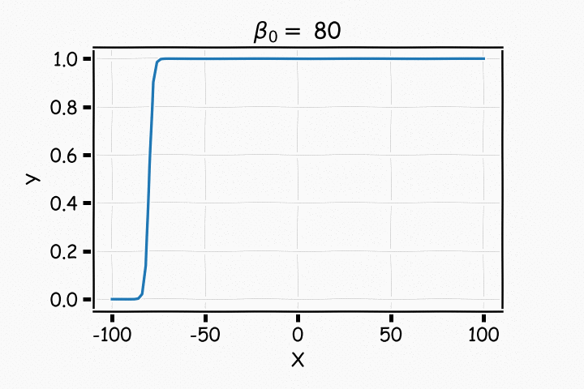
Logistic Regression

Slide 26
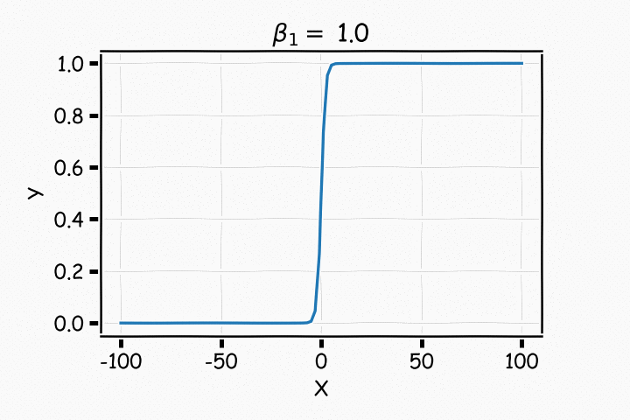
Logistic Regression

Slide 27
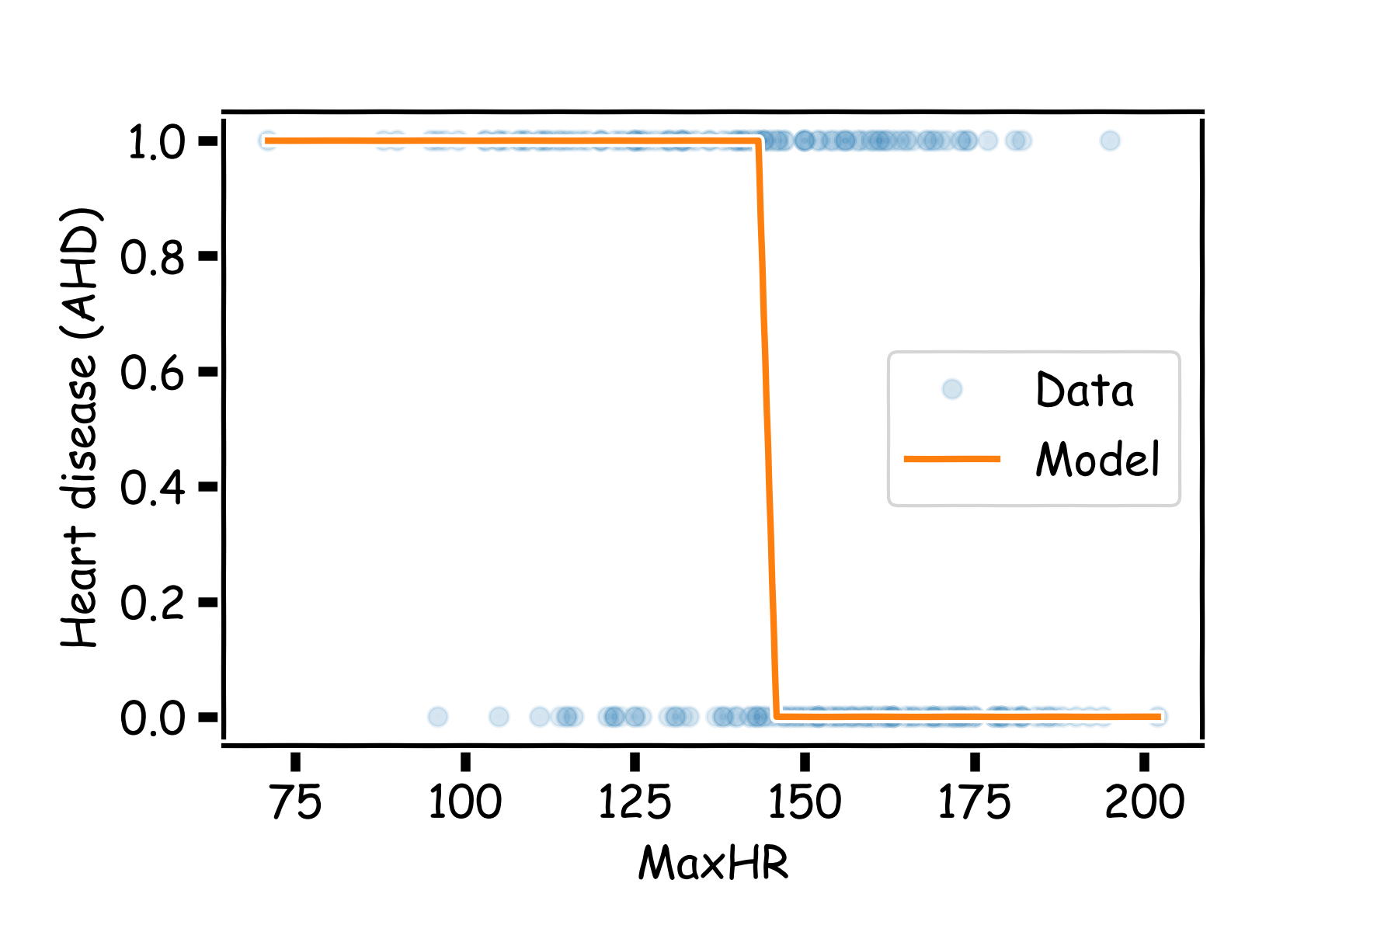
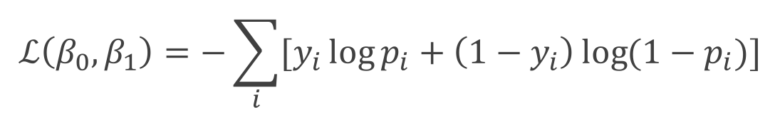
Estimating the coefficients for Logistic Regression
Find the coefficients that minimize the loss function
$$ℒ\left(β_{0}, β_{1}\right)=−\sum_{i}{[y_{i}\log{p_{i}+\left(1−y_{i}\right)\log{(1−p_{i})]}}}$$

Slide 28
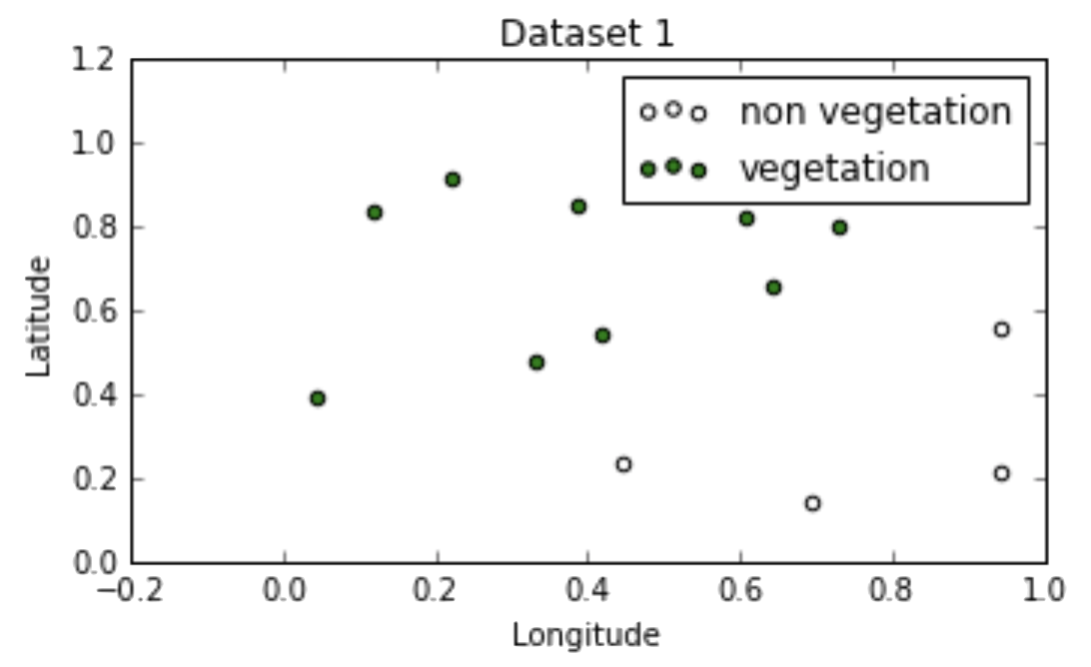
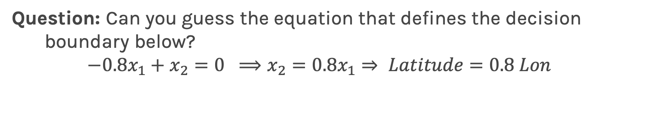
Why go beyond logistic regression?
Question: Can you guess the equation that defines the decision boundary below?
$$−0.8x_{1}+x_{2}=0 ⟹x_{2}=0.8x_{1}⇒ Latitude=0.8 Lon$$

Slide 29
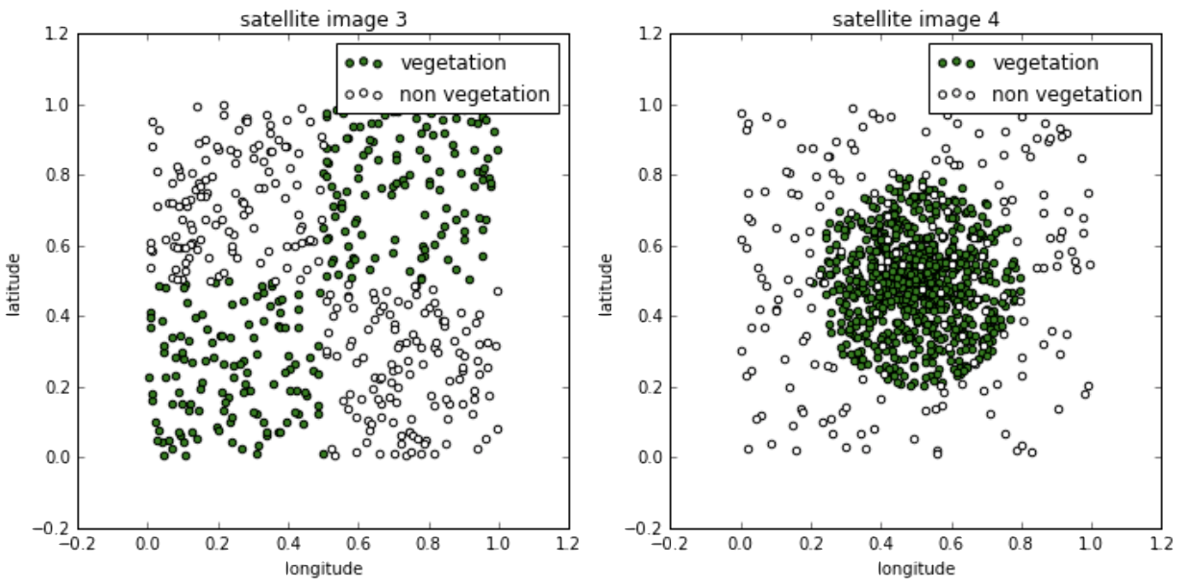
Geometry of Data
Question: How about these?

Slide 30
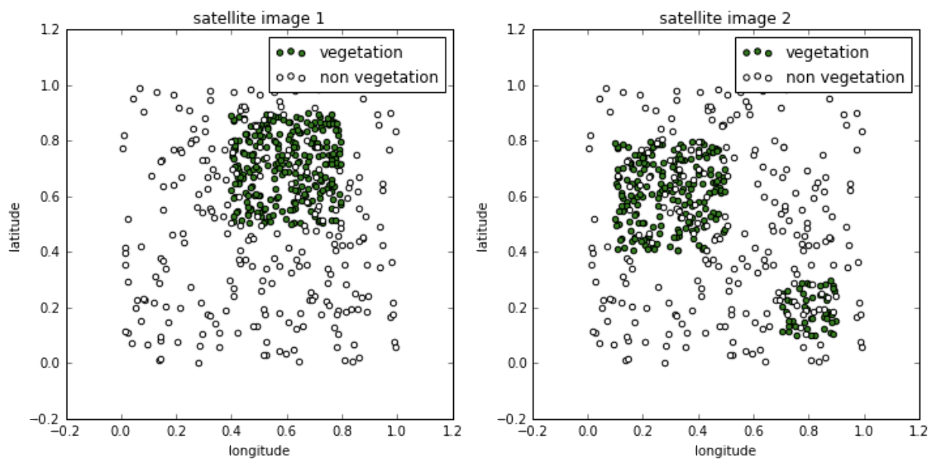
Geometry of Data
Question: Or these?

Slide 31
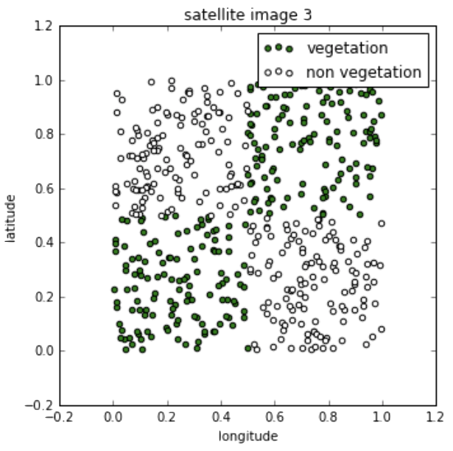
Geometry of Data
Notice that in all of the datasets the classes are still well-separated in the feature space, but the decision boundaries cannot easily be described by single equations:

Slide 32
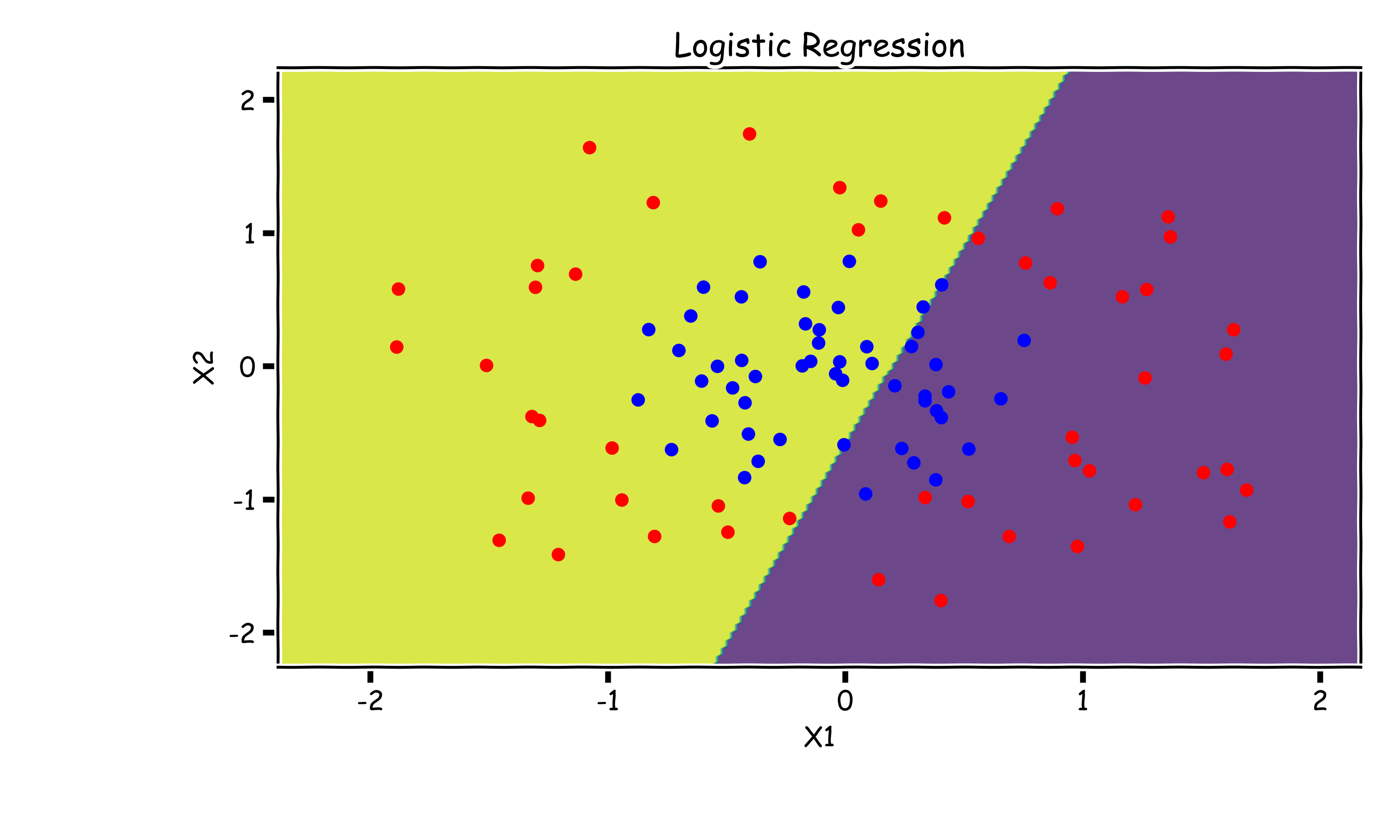
Need for Non-Linearity
Without augmenting the features (i.e. without adding X1² or X2² non-linear features), Logistic Regression is incapable of modeling the correct decision boundary.

Slide 33
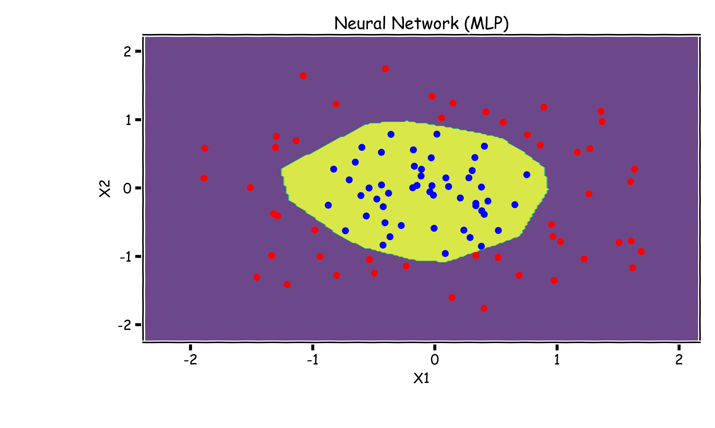
Neural Networks to The Rescue
A neural network is a powerful non-linear model that can easily model the non-linear decision boundary correctly.

Slide 34
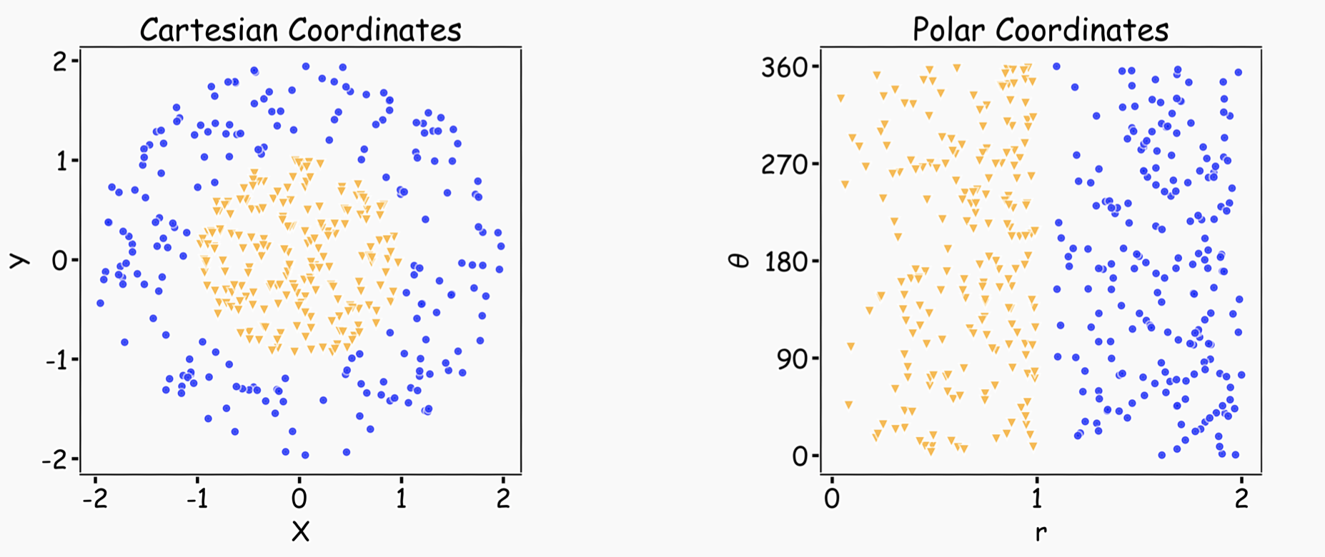
Representation Matters
Neural networks can learn useful representations for the problem. This is another reason why they can be so powerful!

Slide 35
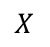
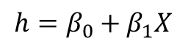
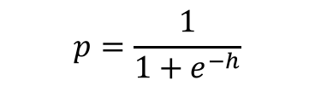
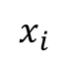
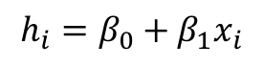
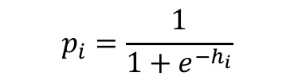
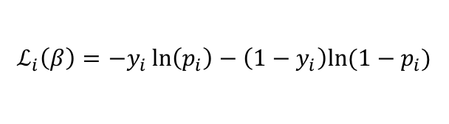
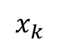
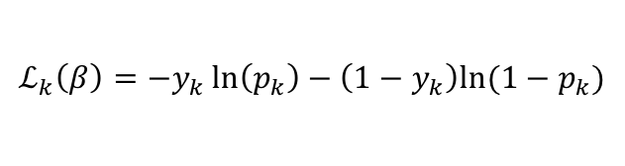
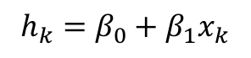
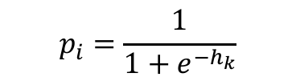

Logistic Regression Revisited
Affine
Activation
Loss Fun
$$p_{i}=\frac{1}{1+e^{−h_{i}}}$$
$$x_{i}$$
$$h_{i}=β_{0}+β_{1}x_{i}$$
$$ℒ_{i}\left(β\right)=−y_{i}\ln\left(p_{i}\right)−\left(1−y_{i}\right)ln⁡(1−p_{i})$$
Affine
Activation
Loss Fun
$$p_{i}=\frac{1}{1+e^{−h_{k}}}$$
$$x_{k}$$
$$h_{k}=β_{0}+β_{1}x_{k}$$
$$ℒ_{k}\left(β\right)=−y_{k}\ln\left(p_{k}\right)−\left(1−y_{k}\right)ln⁡(1−p_{k})$$
…
Affine
Activation
Loss Fun
$$ℒ(β)=\sum_{i}^{n}{ℒ_{i}\left(β\right)}$$
$$p=\frac{1}{1+e^{−h}}$$
$$X$$
$$h=β_{0}+β_{1}X$$

Slide 36
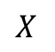
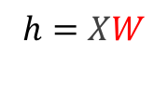
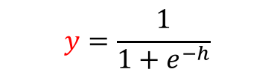

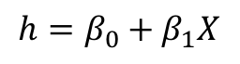
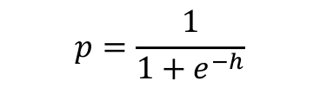

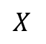
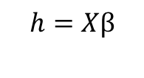
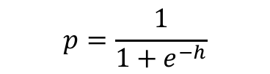

Build our first ANN
Affine
Activation
Loss Fun
$$ℒ(β)=\sum_{i}^{n}{ℒ_{i}\left(β\right)}$$
$$p=\frac{1}{1+e^{−h}}$$
$$X$$
$$h=β_{0}+β_{1}X$$
Affine
Activation
Loss Fun
$$ℒ(β)=\sum_{i}^{n}{ℒ_{i}\left(β\right)}$$
$$p=\frac{1}{1+e^{−h}}$$
$$X$$
$$h=Xβ$$
Affine
Activation
Loss Fun
$$ℒ(W)=\sum_{i}^{n}{ℒ_{i}\left(W\right)}$$
$$y=\frac{1}{1+e^{−h}}$$
$$X$$
$$h=XW$$

Slide 37
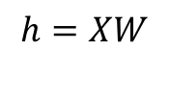
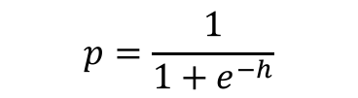
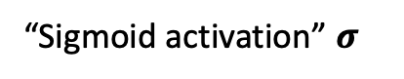


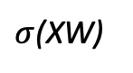

Build our first ANN
Affine
Activation
Loss Fun
$$ℒ(W)=\sum_{i}^{n}{ℒ_{i}\left(W\right)}$$
$$p=\frac{1}{1+e^{−h}}$$
$$X$$
$$h=XW$$
“Sigmoid activation” $σ$
$$X$$
$σ$(XW)
$$Y$$
Single Neuron Network
Very similar to Perceptron

Slide 38
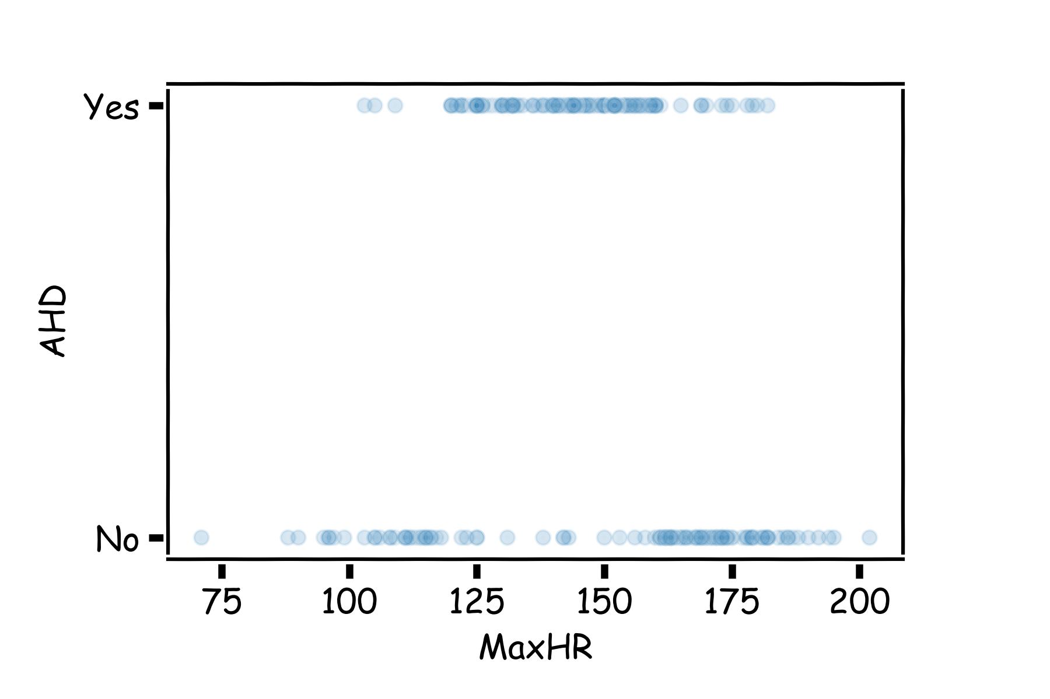
Example Using Heart Data
Slightly modified data to illustrate concepts.

Slide 39
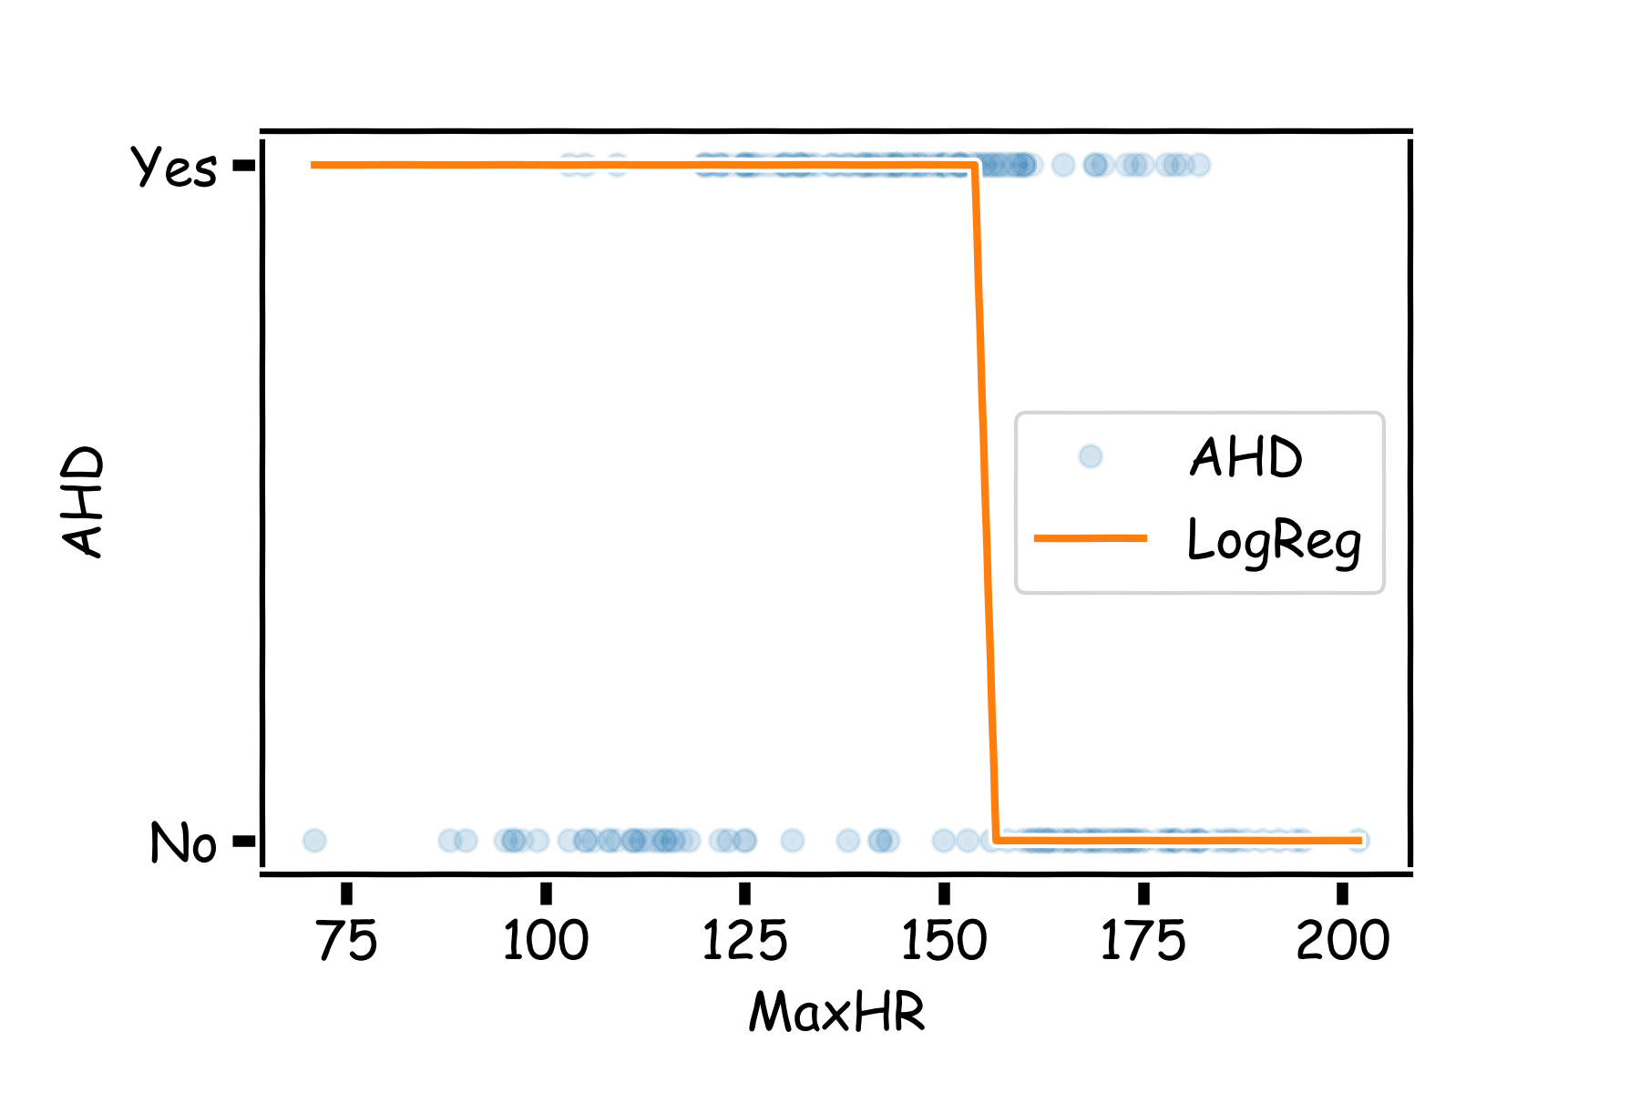


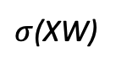
Example Using Heart Data
Choose W such as
$$X$$
$σ$(XW)
$$Y$$

Slide 40
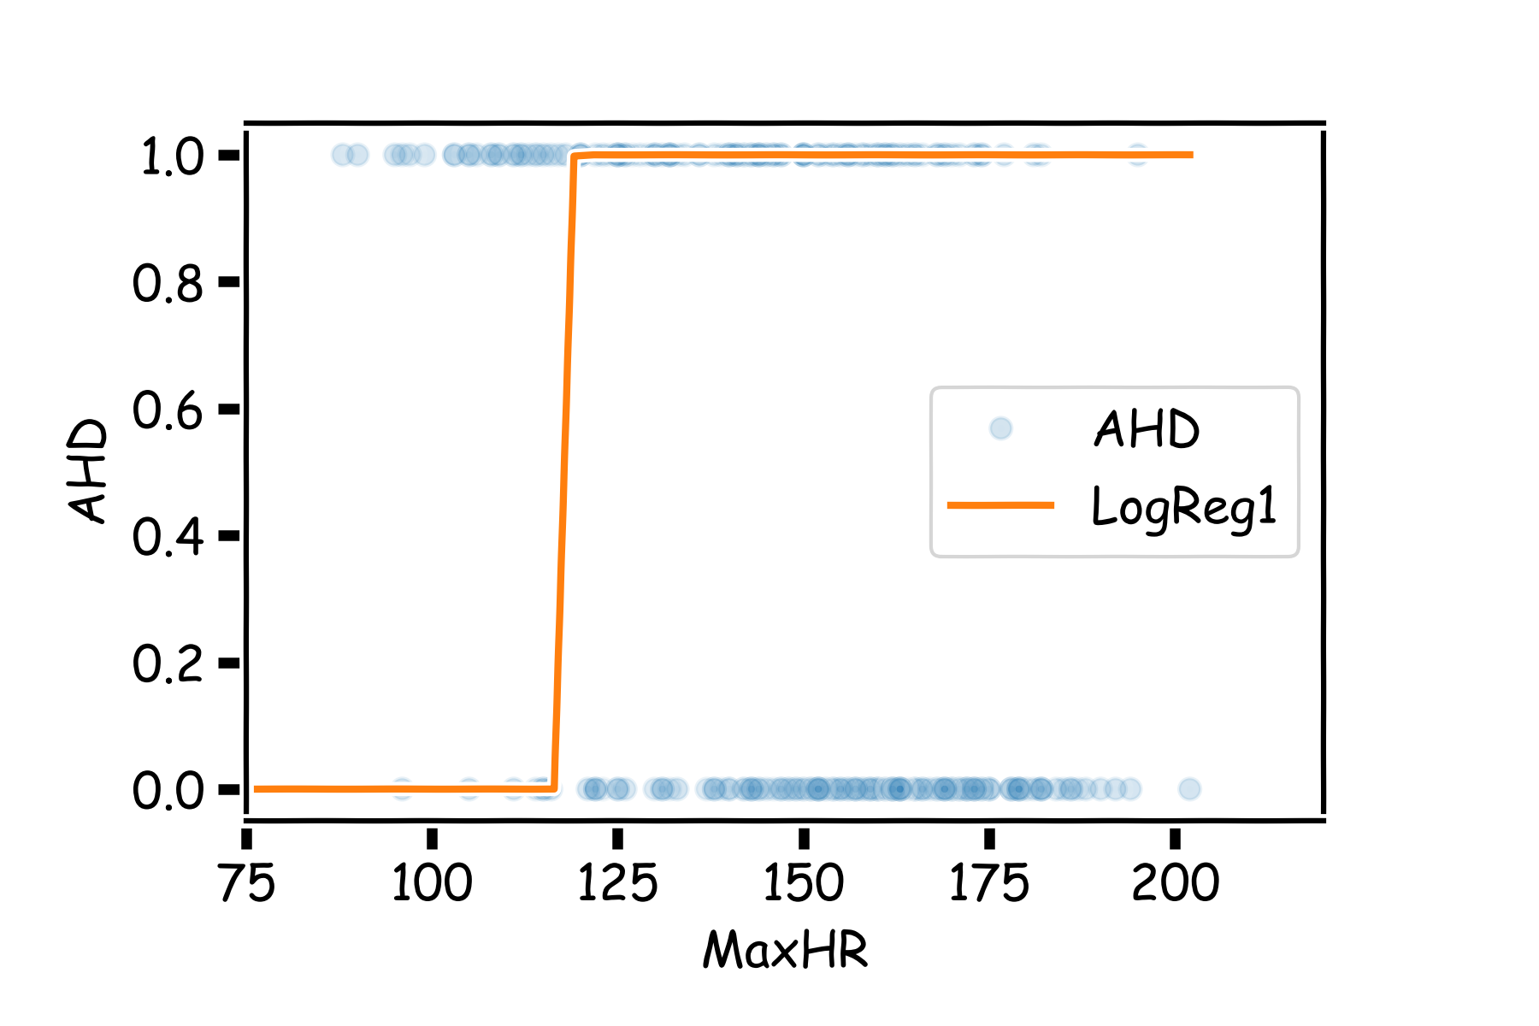

Example Using Heart Data
Choose W such as
$$X$$
$σ$(XW)
$$Y$$

Slide 41







Example
$$X$$
$σ$(XW₁)
$$Y$$
$$X$$
$σ$(XW₂)
$$Y′$$

Slide 42










Pavlos game #232
$σ$(XW₁)
$$Y$$
$$h_{1}$$
$$q= W_{31}h_{1}+{W_{32}h}_{2}+W_{30}$$
Affine (h1 + h2)
$$X$$
$$Y′$$
$$h_{2}$$
Not a probability!
$σ$(XW₂)

Slide 43




Pavlos game #232
$$q= W_{31}h_{1}+{W_{32}h}_{2}+W_{30}$$
$$p=\frac{1}{1+e^{−q}}$$
$σ$(XW₁)
$$Y$$
$$h_{1}$$
$$X$$
$σ$(hW₃)
$σ$(XW₂)
$$Y′$$
$$h_{2}$$
Passing through sigmoid yields probability
$$L=−y ln\left(p\right)−\left(1−y\right)ln(1−p)$$
Need to learn W1, W2 and W3.

Slide 44

Add more combinations of neurons to make interesting functions.
No learning, just combine them

Slide 45

Different weights change shape and position

Slide 46

Combining layers allows us to model increasingly complex functions.

Slide 47

Neural networks can model any reasonable function

Slide 48
Summary
So far:
A single neuron can be a logistic regression unit. We will soon see other choices
A neural network is a combination of logistic regression (or other types) units
A neural network can approximate non-linear functions
Next:
How many neurons
What ”other choices”
And beyond:
How do we estimate weights and biases
Regularize Neural Networks

